Slide 1

5th Sem Self Study Phase -2 Evaluation
Automated Electric Meter Billing
Pratyush singh 1RV16CS104
Hemanth Rao K N 1RV17CS410
Raghavendra 1RV17CS424
Ujwalakavya J 1RV17CS435
Department of Computer Science & Engineering
R V College of Engineering, Bangalore

Slide 2
Presentation Outline
Review of Problem
Use of rapid development tools
Complexity of Implementation
Experimental analysis and presentation of result
Demonstration
Conclusion and Future work
References (Recent IEEE/Springer/ACM/Elsevier papers to be referred)

Slide 3
Review of Problem
An automatic electric meter billing system is an embedded web application.
The project provides a system that allows for reading consumed electricity reading in units as well as to send the amount charged over it to the user.
The application also manages all the information about Electricity, Electricity Board, Customer and billing in the database.

Slide 4
Use of rapid development tools
In this project Rapid Bootstrap framework has been used to integrated with a Admin Template from themeforest.
Any commercial or in-house web site or web application template can be easily integrated with Rapid•Bootstrap from RAD Frameworks.
Sleek, intuitive, and powerful end-to-end framework for faster and easier web development.

Slide 5
Complexity of Implementation
Automated electric bill generating project consists of n ZigBee modem connected to a microcontroller of 8051 family. The embedded micro controller is interfaced with the ZigBee module. This setup is fitted in home.
The energy meter is attached to the micro controller. This controller reads the data from the meter output and transfers that data to ZigBee Module through the serial port.
The embedded micro controller has the knowledge of sending message to the system through the ZigBee module. Another system is placed in EB office, which is the authority office. When they send “unit request” to the microcontroller which is placed in home, then the unit value is sent to the EB office PC through ZigBee module.
According to the readings, the authority officer will send the information about the bill to the customer.

Slide 6
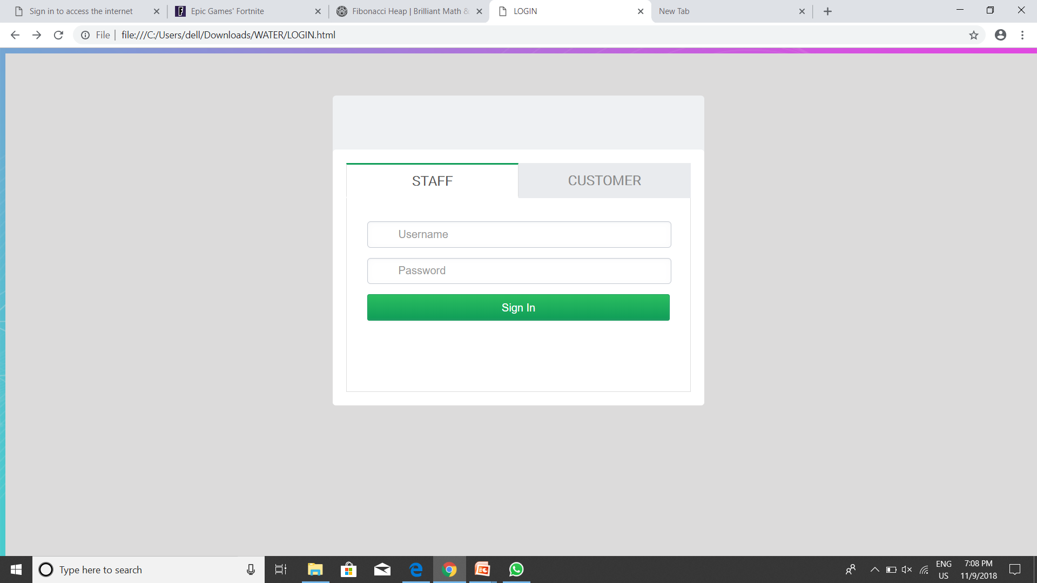
Experimental analysis and presentation of result

Slide 7
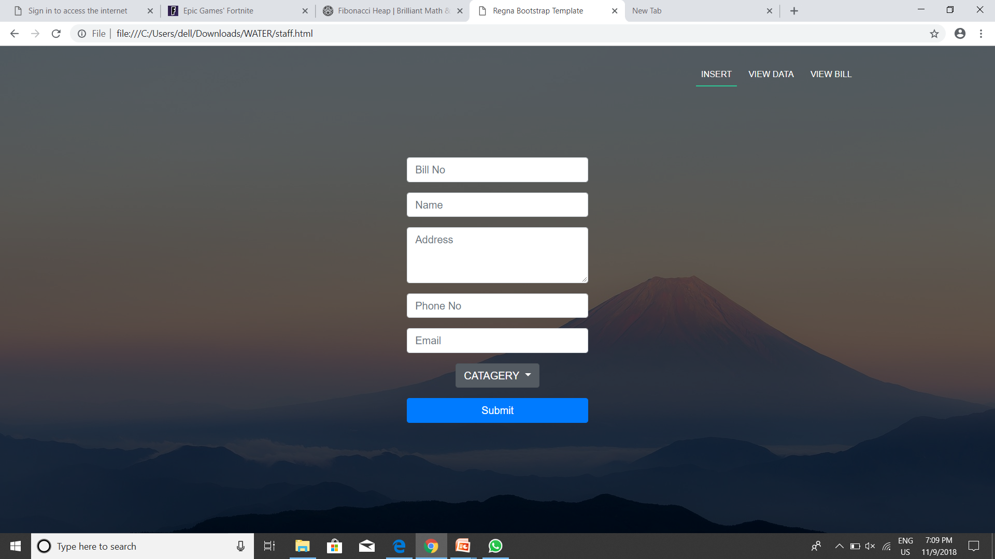

Slide 8
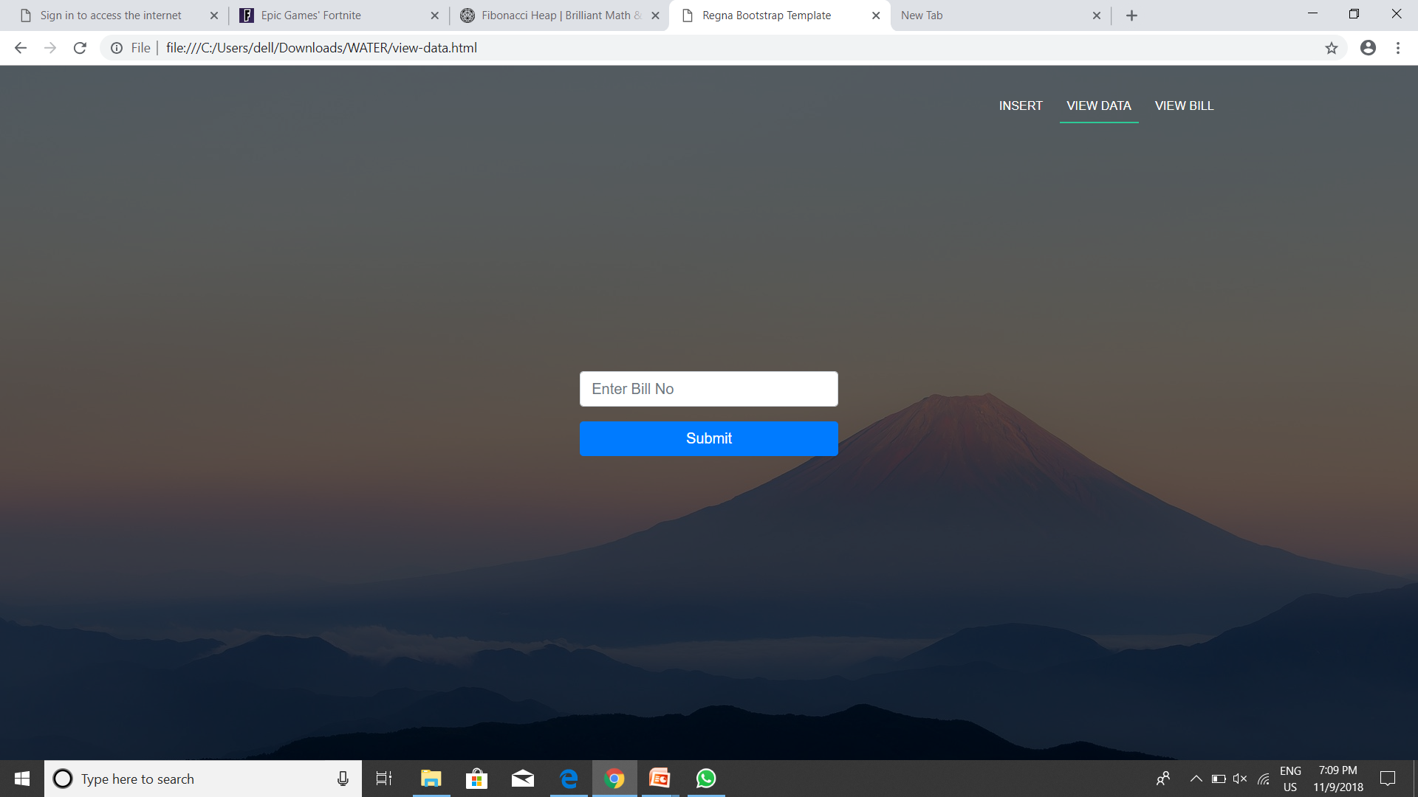

Slide 9


Slide 10
Demonstration

Slide 11
Future work
The cost involved in building of this system could be minimized by using more efficient technology and commercializing it by production in large scale thus reducing the production costs tremendously and hence making it more feasible to be implemented worldwide.
The system could be made more Smart by allowing the user to check for the power consumption and alert him on his power consumption and also allows him to turn off the various devices from his mobile application itself hence conserving energy and saving money.
It will enable the government or the energy provider to predict the energy demand trends consequently ensuring uninterrupted supply of electricity and reducing the unexpected load on the electricity grid making it more tolerant to failures.

Slide 12
Conclusion
Based on all the systems surveyed, their advantages and drawbacks, the features that make up an ideal AMR system and provides a overall insight of the various methodologies applied for AMR so far thus providing a base for further research in this area. Based on the performance criteria considered, several systems where compared and now we come to a conclusion that, when it comes to Reliability and Feasibility Zigbee topped the charts. Web/mobile interface gives a
real-time feedback of the energy consumption, maybe even give the amount of energy consumed by every device in every room and also give energy conservation tips too, based on the data obtained. The real-time data thus obtained can also be used to build a prediction model over it, for predicting the energy demands trends of the future, over any given time period

Slide 13
References
Khanh tuan le, designing a ZigBee-ready ieee 802.15.4-compliant radio transceiver. Chipcon, pp.111,2004
Shahin farahani, “ZigBee wireless networks and transceivers.
W3school tutorials for mysql.
Tutorials point for MongoDB.

Slide 14
Thank You

